Slide 1

Big Data Analytics
End-Term Review T12
B-88
04/06/2022
1

Slide 2
Agenda
Problem Statement
Introduction
Literature Survey
Terminology
Objectives
Architecture
Implementation

Slide 3
Problem Statement and Group Details
“Novel non-invasive approach towards haemoglobin level identification using deep learning”
Members:
Atharva Belamkar
Tushar Birari
Akhil Bannur
Sanskar Sharma
Faculty:
Prof. Shilpa Sonawani – Internal Guide

Slide 4
Introduction
Anemia is a condition within which you lack enough healthy red blood cells to hold adequate oxygen to your body's tissues. Having anemia, also spoken as low hemoglobin, can cause you to feel tired and weak.
The lower threshold generally accepted for the concentration of haemoglobin within the blood for the adult population are: 13.0 g/dL in men and 12.0 g/dL in women; a specific tolerance due to different age and race should be considered
Recurrent symptoms common to all or any styles of anemia include fatigue, dizziness or light-headedness, headache, pallor, chest pain, weakness, irregular heartbeat, shortness of breath, and cold hands and feet. During the physical examination, heart rate, rate of respiration and conjunctival pallor of the tongue or nail bed are evaluated.
Haemoglobin predominantly absorbs green light and reflects red light, and as a result haemoglobin concentration affects tissue colour. An “erythema index” (EI) has been developed to objectively quantify the degree of erythema of skin lesions, using photography followed by analysis of the red and green components of images.

Slide 5
Literature Survey
Sr. No. | PAPER TITLE | NAME OF THE AUTHORS | NAME OF JOURNAL | DATE OF PUBLICATION | DOTLINK | SUMMARY | TECHNIQUE
1 | Detecting Clinical Signs of Anaemia From Digital Images of the Palpebral Conjunctiva | Giovanni Dimauro; Attilio Guarini; Danilo Caivano; Francesco Girardi; Crescenza Pasciolla; Angela Iacobazzi | IEEE | July 31, 2019 | https://ieeexplore.ieee.org/document/8782533 | The aim is to quantify and minimize the subjective nature of the examination of the palpebral conjunctiva, suggesting a method of diagnostic support and autonomous monitoring. Here we describe the methodology and system for extracting key data from the digital image of the conjunctiva. Effective features have been used herein to establish the inclusion of each image in a diagnosis probability class for anaemia. . | The images of the conjunctiva were taken using a device, designed to optimize the properties of independence from ambient light. The performance of the system was tested either by extracting manually the palpebral conjunctiva from images or by extracting them in a semi-automatic way based on the SLIC Superpixel algorithm. The SMOTE and ROSE algorithms were evaluated to balance the dataset, and some classification algorithms for assessing the anaemic condition were tested.

Slide 6
Literature Survey Cont..
Sr. No. | PAPER TITLE | NAME OF THE AUTHORS | NAME OF JOURNAL | DATE OF PUBLICATION | DOTLINK | SUMMARY | TECHNIQUE
2 | Prediction of anemia and estimation of hemoglobin concentration using a smartphone camera | Selim Suner , James Rayner , Ibrahim U. Ozturan , Geoffrey Hogan, Caroline P. Meehan , Alison B. Chambers, Janette Baird, Gregory D. Jay | PLOS ONE | July 14, 2021 | https://journals.plos.org/plosone/article?id=10.1371/journal.pone.0253495 | All images were collected from patients who were in the ED at Rhode Island Hospital between October 5, 2018 and August 14, 2019 for any chief complaint. | A database was generated, in order to merge and organize information from each RAW image with patient clinical data. Using MATLAB, an application was created which displayed each image for the user to visually inspect and provided a user interface to eliminate images which are not suitable for processing such as those which partially omit the conjunctiva, have poor lighting or are completely out of focus. For all valid images, the user was prompted to select a point within the palpebral conjunctiva representative of overall conjunctiva color, with a mouse click. A region of interest (ROI) representing best color was visually selected as a rectangle of standard size around the selected seed point

Slide 7
Literature Survey Cont..
Sr. No. | PAPER TITLE | NAME OF THE AUTHORS | NAME OF JOURNAL | DATE OF PUBLICATION | DOTLINK | SUMMARY | TECHNIQUE
3 | Neural Network Based Non-Invasive Method to Detect Anemia From Images of Eye Conjunctiva | Prakhar Jain, Shubham Bauskar, Manasi Gyanchandani | International Journal of Imaging Systems and Technology | July 25, 2019 | https://doi.org/10.1002/ima.22359 | A novel machine learning model using the artificial neural network is proposed to detect anemic patients from the images of eye conjunctiva and increased available training images using image augmentation techniques. The model's accuracy was 97.00% with sensitivity of 99.21% and specificity of 95.42% on the created dataset. | Describes the process of preprocessing the dataset containing images of eye conjunctiva of patients and extracting the region of interest (ROI). After ROI is extracted, new images are created using image augmentation to the dataset size and predicting the result class, that is, anemic or non-anemic using the proposed model.

Slide 8
Literature Survey Cont..
Sr. No. | PAPER TITLE | NAME OF THE AUTHORS | NAME OF JOURNAL | DATE OF PUBLICATION | DOTLINK | SUMMARY | TECHNIQUE
4 | Non-Invasive Detection of Anaemia Using Digital Photographs of the Conjunctiva | Shaun Collings, Oliver Thompson, Evan Hirst, Louise Goossens, Anup George, Robert Weinkove | PLOS ONE | April 12, 2016 | https://doi.org/10.1371/journal.pone.0153286 | Aimed to detect anaemia by quantifying conjunctival pallor using digital photographs, the goal was to develop a non-invasive screening test for anaemia. Using the compact camera, palpebral conjunctival EI had a sensitivity of 93% and 57% and specificity of 78% and 83% for detection of anaemia in training and internal validation sets, respectively. | The conjunctivae of haemato-oncology in and outpatients were photographed in ambient lighting using a digital camera, and the internal rear-facing camera of a smartphone alongside an in-frame calibration card. Following image calibration, conjunctival erythema index (EI) was calculated and correlated with laboratory measured hemoglobin concentration.

Slide 9
Literature Survey Cont..
Sr. No. | PAPER TITLE | NAME OF THE AUTHORS | NAME OF JOURNAL | DATE OF PUBLICATION | DOTLINK | SUMMARY | TECHNIQUE
5 | Non Evasive Blood Screening of haemoglobin using smartphone cameras | 1.Edward Jay Wang 2.William Li 3. Doug Hawkins 4.Terry Gernsheimer 5.Shwetak N. Patel | Association for Computing Machinery (ACM) | September 2016 | https://dl.acm.org/doi/10.1145/2971648.2971653 | Hemoglobin measurement is a standard clinical tool commonly used for screening anemia and assessing a patient’s response to iron supplement treatments. Given a light source shining through a patient’s finger, The research performed a chromatic analysis, analyzing the color of their blood to estimate hemoglobin level | This paper presents a smartphone application that noninvasively monitors the hemoglobin concentration using the smartphone’s camera and different lighting sources. Monitoring hemoglobin is a standard clinical tool for both screening and assessing a patient’s response to treatment. This research was evaluated on 31 patients ranging from 6 – 77 years of age using three different embodiments of our system. The first uses LEDs commonly found on smartphones. The second augments the phone with an incandescent light source. Finally, the third both augments the phone with an incandescent source and uses a custom LED setup

Slide 10
Literature Survey Cont..
Sr. No. | PAPER TITLE | NAME OF THE AUTHORS | NAME OF JOURNAL | DATE OF PUBLICATION | DOTLINK | SUMMARY | TECHNIQUE
6 | Detection of Anemia from Image of the Anterior Conjunctiva of the Eye by Image Processing and Thresholding | 1. Chowdhury S. Jahan 2.Celia Shahnaz 3.Mohammad S. Saif 4.Sums U. Zaman 5. Shaikh Anowarul Fattah | IEEE | Dec 2017 | https://ieeexplore.ieee.org/document/8289053 | The process involves the detection of anemia by analyzing the anterior conjunctival pallor of the eye. It operates by quantifying the conjunctival color from digital photographs of the eye taken with a smartphone camera of appropriate resolution under adequate lighting conditions with the help of an android application that we have devised | This paper presents a non-invasive process for the successful detection of anemia with a 78.9% accuracy. The process involves taking a picture of the conjunctival pallor of the eye using the camera of a smartphone with suitable regulation in sufficient lighting with the help of an android application which we devised. The image taken is next transferred to a computer via the internet or any other means available. A computer program then processes the image to extract RGB spectrum of the anterior conjunctival pallor and compares it with a pre-determined threshold value to conclude whether the subject is anemic or not.

Slide 11
Literature Survey Cont..
Sr. No. | PAPER TITLE | NAME OF THE AUTHORS | NAME OF JOURNAL | DATE OF PUBLICATION | DOTLINK | SUMMARY | TECHNIQUE
7 | Non-invasive Self-Care Anemia Detection during Pregnancy Using a Smartphone Camera | M. D. Anggraeni, and A. Fatoni | IOP Science | September 2016 | https://iopscience.iop.org/article/10.1088/1757-899X/172/1/012030 | Indonesian maternal mortality rate is the highest in South-East Asia. Postpartum haemorrhage is the major causes of maternal mortality in Indonesia. Anemia during pregnancy contributes significantly to postpartum hemorrhage. Early detection of anemia during pregnancy may save mothers from maternal death. This preliminary study may be used as anemia early detection which more objective compared to visual assessment usually performed. | The images were generated from smartphone camera (Asus ZenFone 2 Laser, rear camera, 13 MP, laser autofocus, f/2.0 aperture). Photos are to be taken in ambient lighting, without flash, and at a distance about 30-40 cm. The color intensity is measured using Colorgrab software (Loomatix) and compared to the hemoglobin concentration of the samples from standard Spectrophotometer method.

Slide 12
Literature Survey Cont..
Sr. No. | PAPER TITLE | NAME OF THE AUTHORS | NAME OF JOURNAL | DATE OF PUBLICATION | DOTLINK | SUMMARY | TECHNIQUE
8 | Examining palpebral conjunctiva for anemia assessment with image processing methods | Yi-Ming Chen Shaou-Gang Miaou Hongyu Bian | Computer Methods and Programs in Biomedicine | Dec 2016 | https://www.sciencedirect.com/science/article/abs/pii/S0169260716302474?via%3Dihub | Developed two image processing algorithms of anemia test and assessed their performance. In the first algorithm, we extract two low correlated features, PVM and HHR, in two different color spaces and do a simple thresholding classification along with a minimum distance classifier. used SVM and ANN to do classification, achieving a better recognition performance than that of the first algorithm. | Used a digital camera (SONY DSC-T1100) to take a photo of a patient’s palpebral conjunctiva after pulling down his or her eyelid The camera was operated in the automatic white balance mode without flash light. Implement the most basic version of the ANN and SVM.

Slide 13
Literature Survey Cont..
Sr. No. | PAPER TITLE | NAME OF THE AUTHORS | NAME OF JOURNAL | DATE OF PUBLICATION | DOTLINK | SUMMARY | TECHNIQUE
9 | Non-Invasive Determination of Hemoglobin by Digital Photography of Palpebral Conjunctiva | Gregory Crawford Selim Suner John McMurdy Gregory Jay | Journal of Emergency Medicine | Aug 2007 | https://www.sciencedirect.com/science/article/abs/pii/S0736467907001412 | EI of the palpebral conjunctiva correlated more strongly with haemoglobin concentration than that of the forniceal conjunctiva. Using the compact camera, palpebral conjunctival EI had a sensitivity of 93% and 57% and specificity of 78% and 83% for detection of anaemia (haemoglobin < 110 g/L) in training and internal validation sets, respectively. Similar results were found using the iPhone camera, though the EI cut-off value differed. | The conjunctivae of haemato-oncology in- and outpatients were photographed in ambient lighting using a digital camera (Panasonic DMC-LX5), and the internal rear-facing camera of a smartphone (Apple iPhone 5S) alongside an in-frame calibration card An “erythema index” (EI) has been developed to objectively quantify the degree of erythema of skin lesions, using digital photography followed by analysis of the red and green components of images

Slide 14
Literature Survey Cont..
Sr. No. | PAPER TITLE | NAME OF THE AUTHORS | NAME OF JOURNAL | DATE OF PUBLICATION | DOTLINK | SUMMARY | TECHNIQUE
10 | Dataset for the detection of anaemia using conjunctival images | Collings, Shaun | Harvard Dataverse | 2015 | https://dataverse.harvard.edu/dataset.xhtml?persistentId=doi:10.7910/DVN/L4MDKC | Dataset for the clinical study on the quantification of conjunctival pallor from digital camera images for the non-invasive detection of anaemia (2015-09-30) | NA

Slide 15

Terminology
Erythema Index:
Erythema means redness where high erythema is more redness and vice versa.
The instrument compares the intensity of the non-specular, reflected red (I_{red}) and green light (I_{green}) calculated as an "erythema index" (E)
The instrument used is known as dermaspectrometer.
EI of the palpebral conjunctiva correlates strongly with haemoglobin concentration.

Slide 16
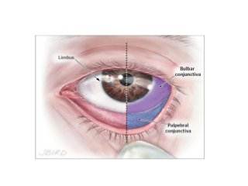

Terminology
Palpebral Conjunctiva:
The part of the conjunctiva, a clear membrane, that coats the inside of the eyelids. The palpebral conjunctiva is as opposed to the ocular (or bulbar) conjunctiva, the part of the conjunctiva that covers the outer surface of the eye.

Slide 17
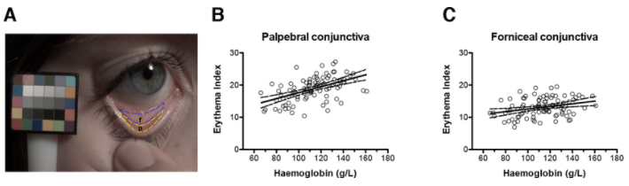
HGB and EI
Relationship between erythema index and haemoglobin for palpebral and forniceal conjunctiva.
(A) Representative calibrated image from a non-anaemic participant showing the palpebral (p) and forniceal (f) portions of the conjunctiva. The in-frame colour calibration target is shown.
(B) Relationship between palpebral conjunctival EI derived from LX5 images and measured haemoglobin (n = 94). Solid line represents best fit by linear regression; slope = 0.092 ± 0.016; P < 0.0001 of zero slope. Dashed line represents 95% confidence interval.
(C) Relationship between forniceal conjunctival EI derived from LX5 images and measured haemoglobin (n = 94). Solid line represents best fit by linear regression; slope = 0.040 ± 0.014; P = 0.004 of zero slope. Dashed line represents 95% confidence interval.

Slide 18
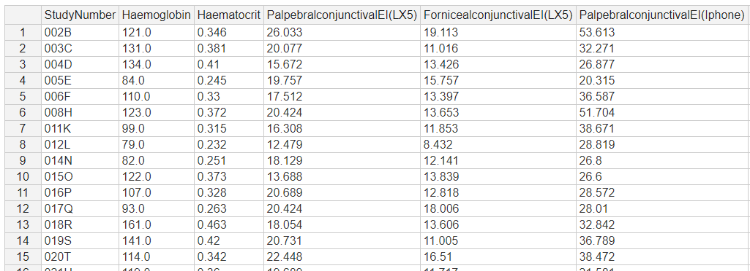
HGB and EI
Available data has values of haemoglobin and erythema index of palpebral conjunctiva using smartphone and digital camera of a group of 108 people with a mix of being anemic and non-anemic.

Slide 19
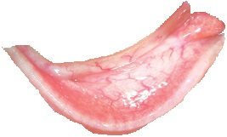
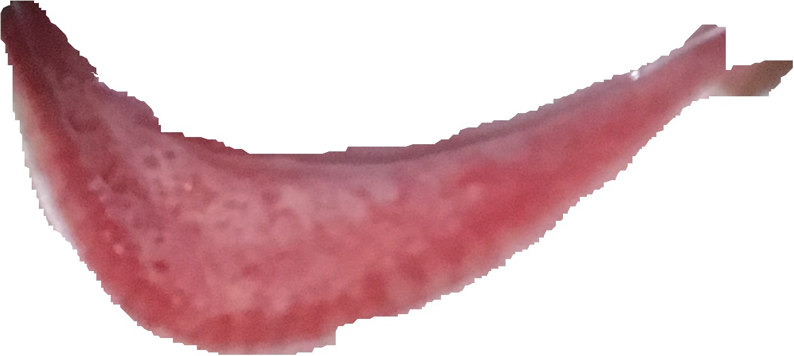
Available Images Dataset
We have used an available unlabelled dataset for reference and testing purpose before creating our own dataset.
Anemic
Non Anemic

Slide 20
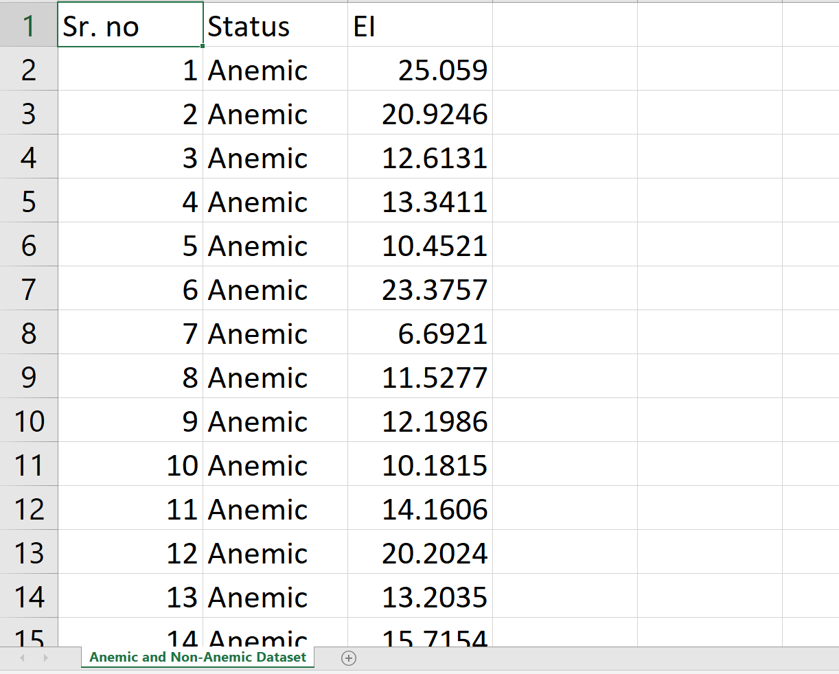
Existing Dataset Values

Slide 21
Objectives
On the dataset then we aim to apply different image processing algorithms like the SLIC superpixel algorithm, to segment the image into different pixel densities.
Then calculate the Erythema Index value by getting the reg and green values from the selected pixel.
Create a dataset consisting of the EI values corresponding to the image number.
Training the existing Harvard dataset using different models and using the above generated dataset to get the approximate hemoglobin values.

Slide 22
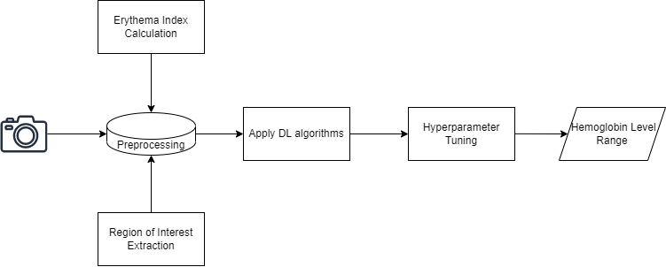
Architecture
High Level Design

Slide 23
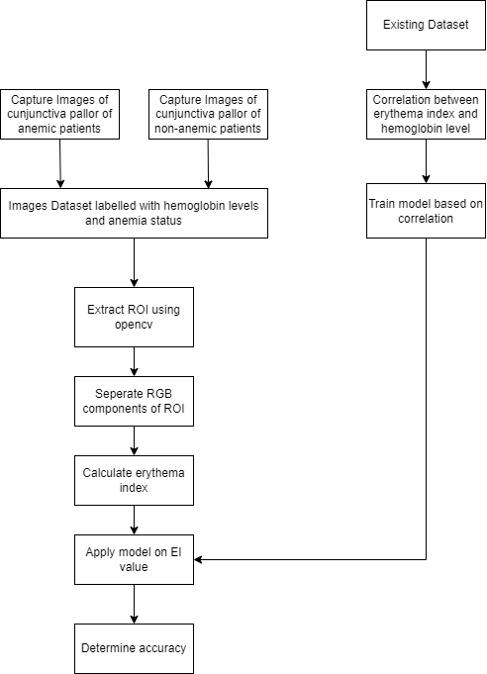
Architecture
Low Level Design

Slide 24
Implementation
SLIC Superpixel Algorithm:
A superpixel can be defined as a group of pixels that share common characteristics (like pixel intensity ).
Image Segmentation is the process of partitioning an image into multiple segments(set of pixels or superpixels).
The goal is to represent the image as something that is more meaningful and easier to analyze.
In other words, image segmentation is the process of assigning a label to every pixel in an image such that pixels with the same label share certain characteristics. Segmentation can be used to locate objects and boundaries (lines, curves etc.) in images. Some of its practical applications are in -
Medical Imaging
Object detection (Face, pedestrian detection)
Recognition Tasks (Face, Fingerprint recognition)

Slide 25
Implementation
Advantages of superpixels:
They carry more information than pixels.
Superpixels have a perceptual meaning since pixels belonging to a given superpixel share similar visual properties.
They provide a convenient and compact representation of images that can be very useful for computationally demanding problems.

Slide 26
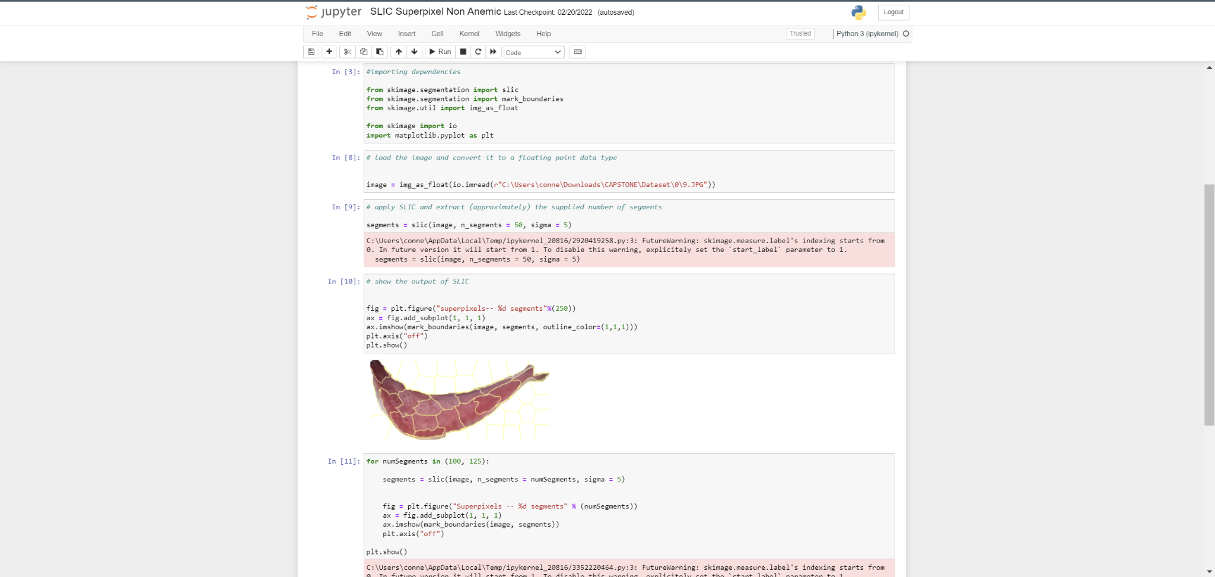
Implementation
SLIC Superpixel Algorithm Implementation

Slide 27
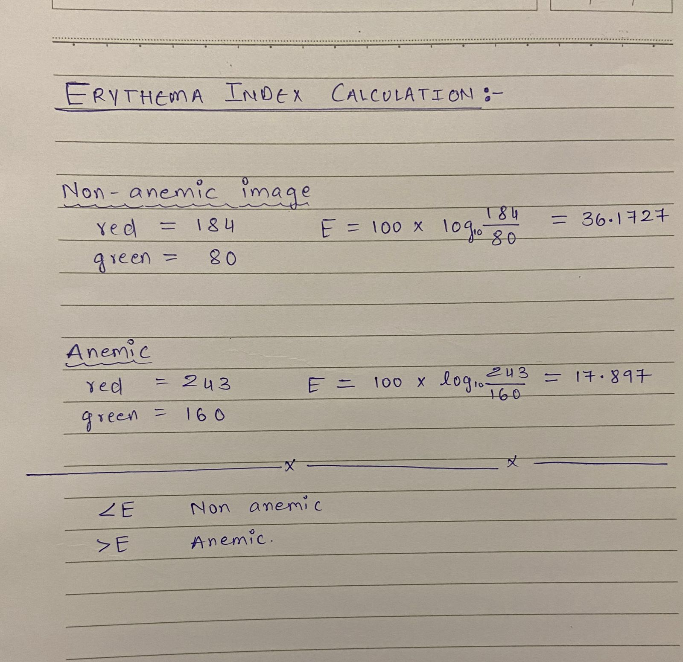
Implementation

Slide 28
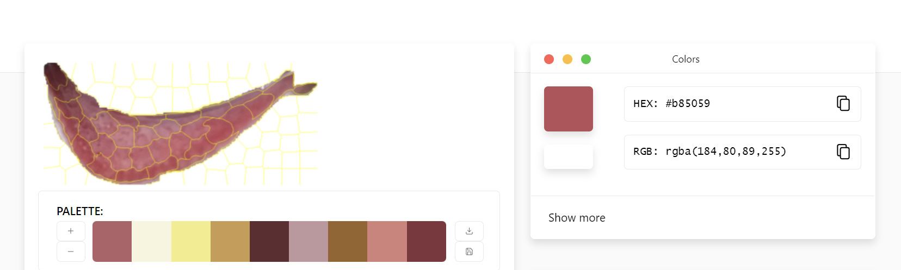
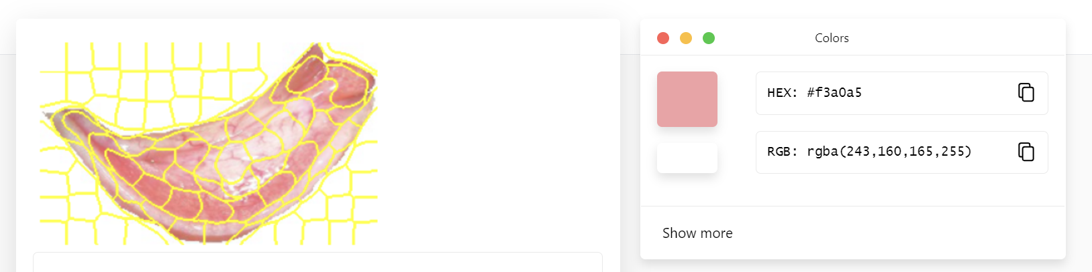
Implementation
Non-Anemic
Anemic

Slide 29
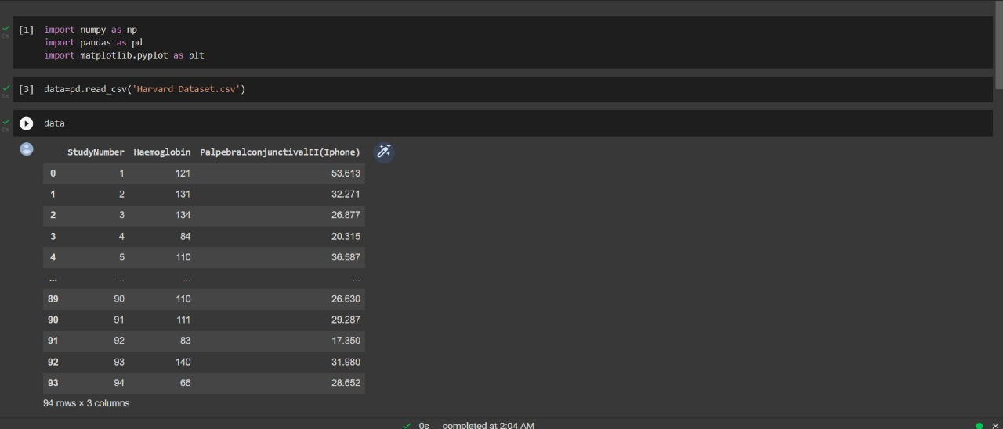
Implementation
Anemic

Slide 30
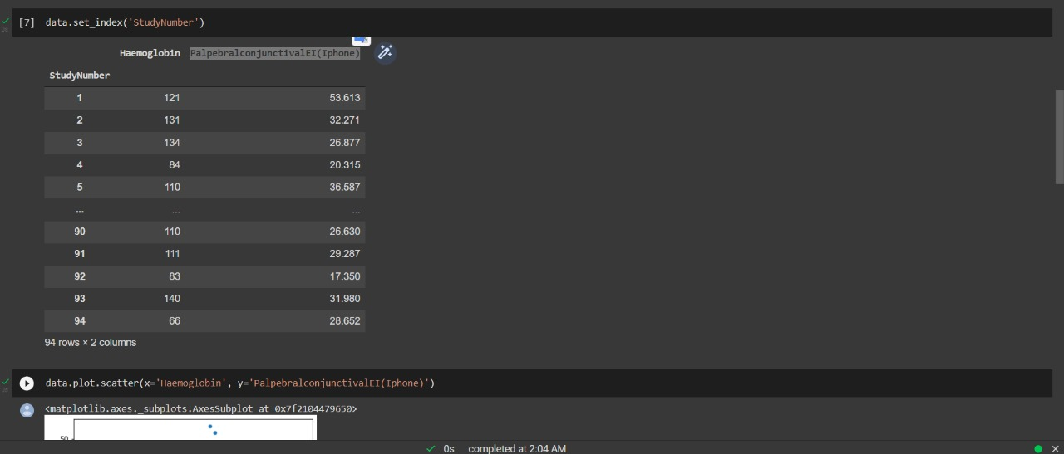
Implementation
Anemic

Slide 31
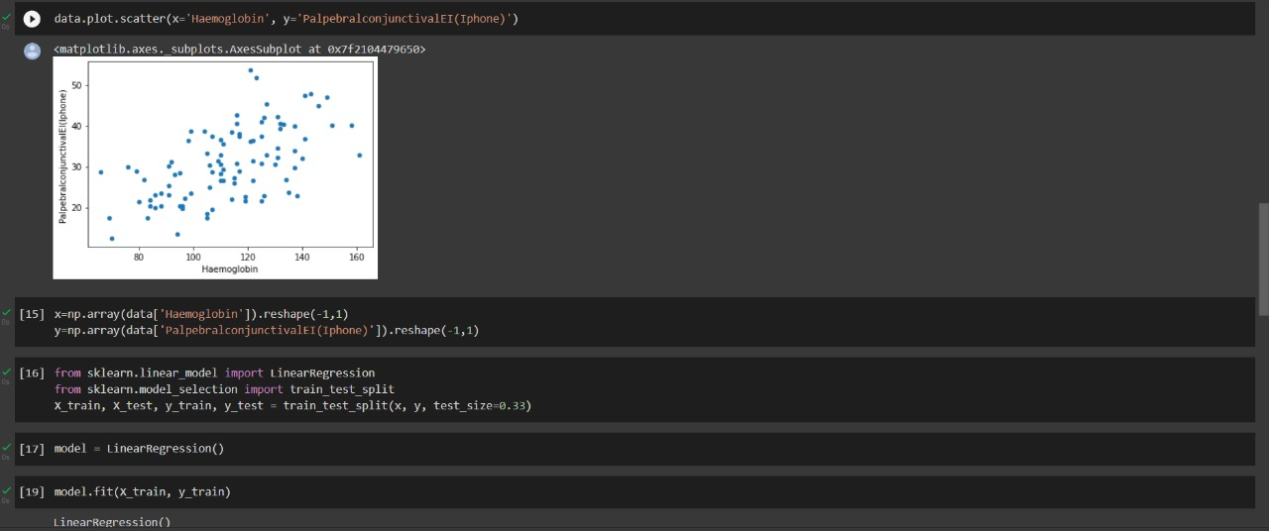
Implementation
Anemic

Slide 32
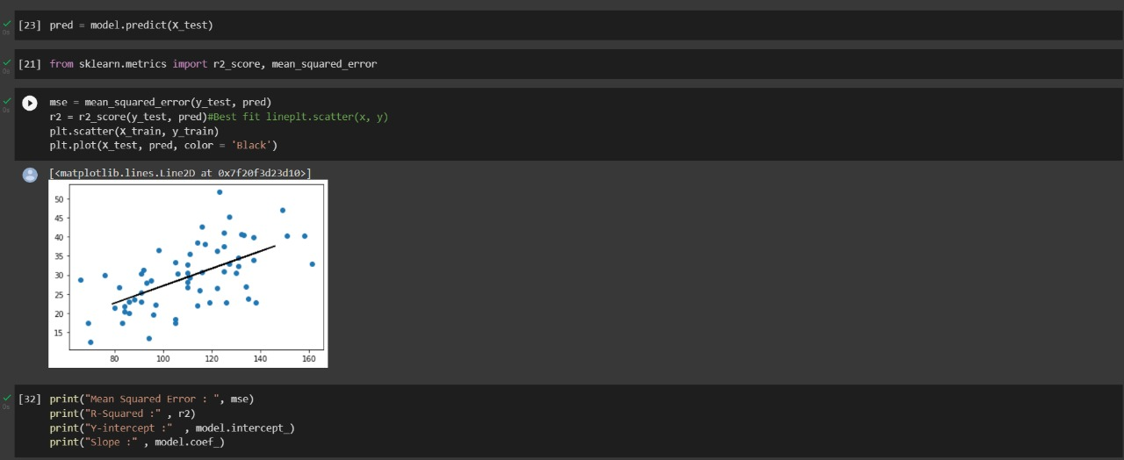
Implementation
Anemic

Slide 33
Obtained Results
Due to limited data, this version of our project led to lower accuracy than expected. However higher accuracy can be achieved with the help of more data which is currently difficult to obtain.
MSE Score: 43.40809065050047
RMSE Score: 0.34265576225925964

Slide 34
Limitations
Less than 100 data points causing the model to underfit when using certain algorithms
Different cameras have different types of photo processing methods, hampering the image processing.

Slide 35
THANK YOU
QnA

